Slide 1

Predicting Wine Quality
Dustin Syrjanen

Slide 2
Goals
Read the objective test data listed for each wine sample
01
Compare the objective test data to the subjective wine grades
02
Predict the wine grade using a classification model
03

Slide 3
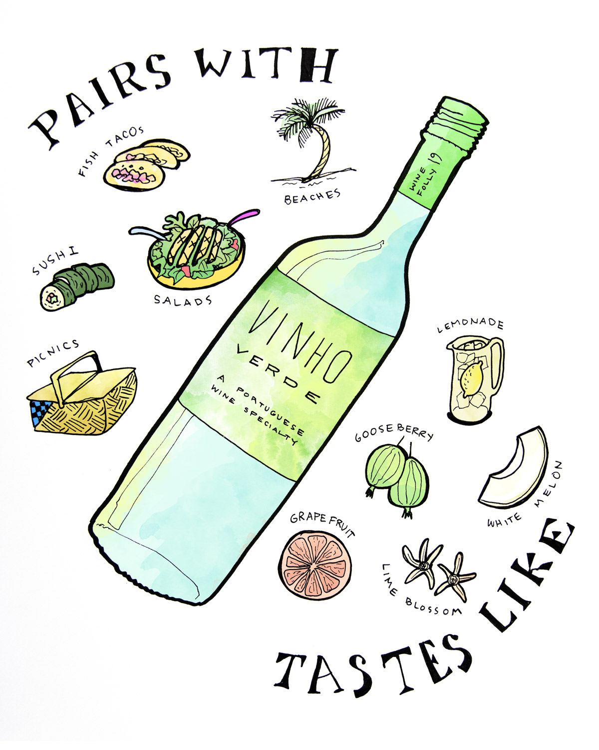
Background
Two datasets were created using red and white wine variants of the Portuguese “Vinho Verde” wine.
Vinho Verde wine comes from a small region of Northern Portugal
Known as a “super-value” wine
Vast majority are white wines
The inputs include 11 different objective attributes (alcohol, pH, etc.)
The output is the median of at least three wine experts
Quality scores are listed between 1 and 10
There are no data points listed for type of grape, brand, or price due to privacy issues
Number of Instances:
Red wine – 1,599
White wine – 4,898

Slide 4
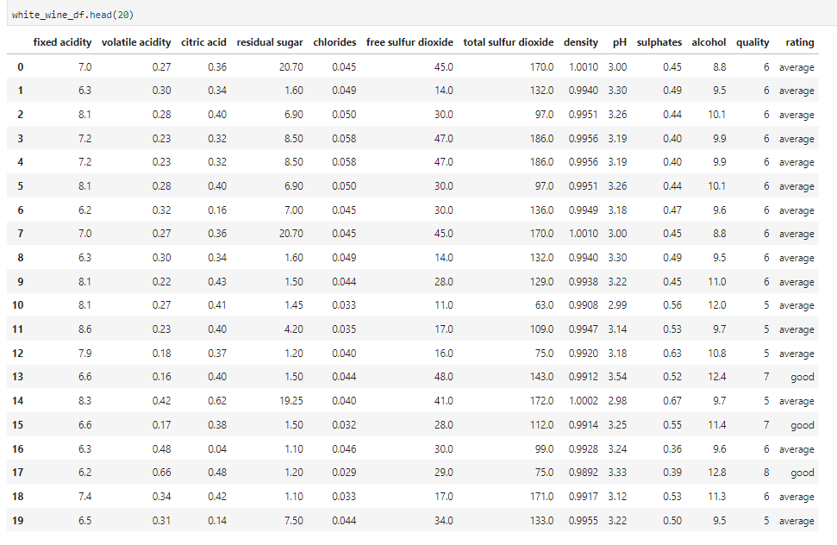
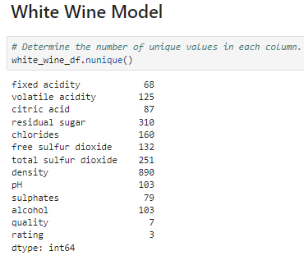
Data

Slide 5
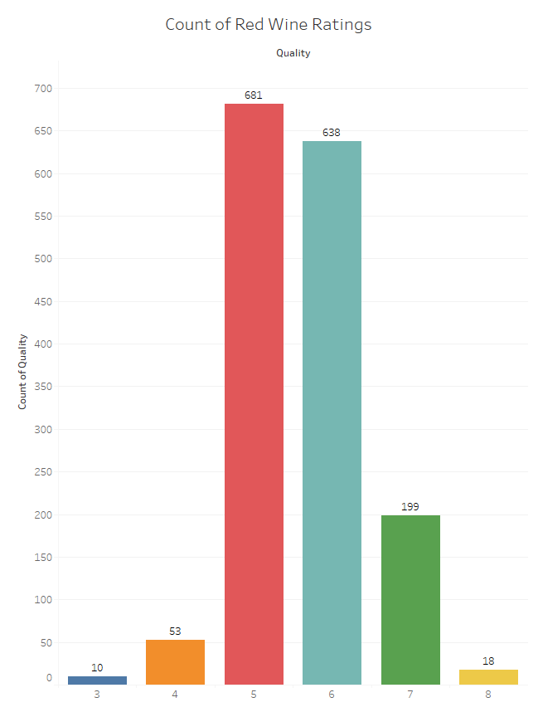
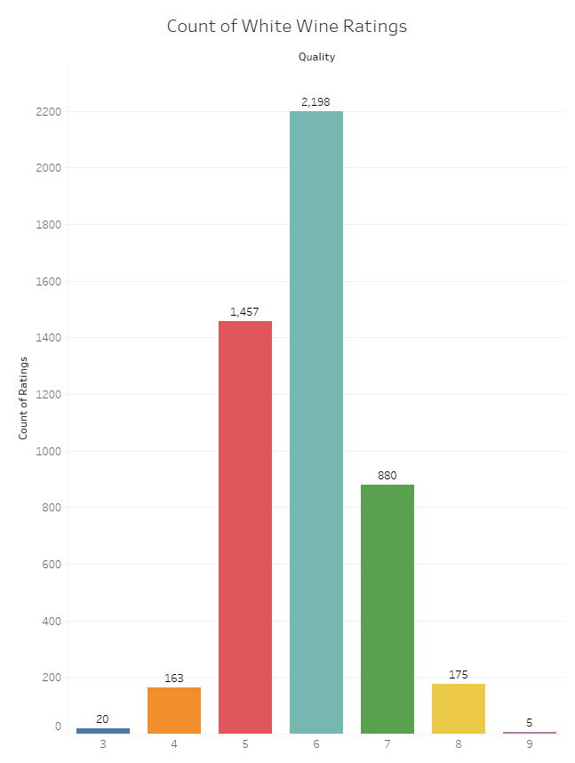

Slide 6
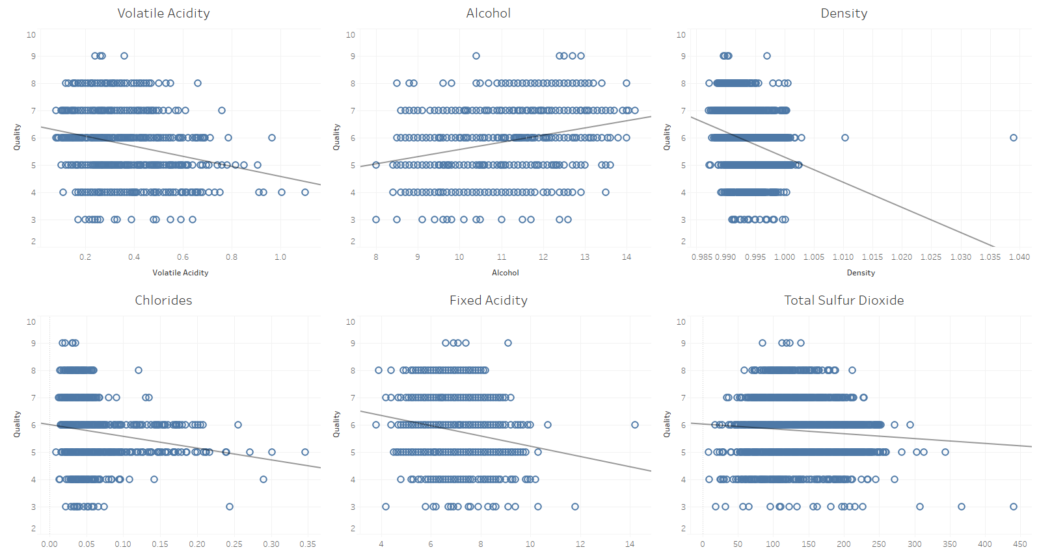
White Wine Trends

Slide 7
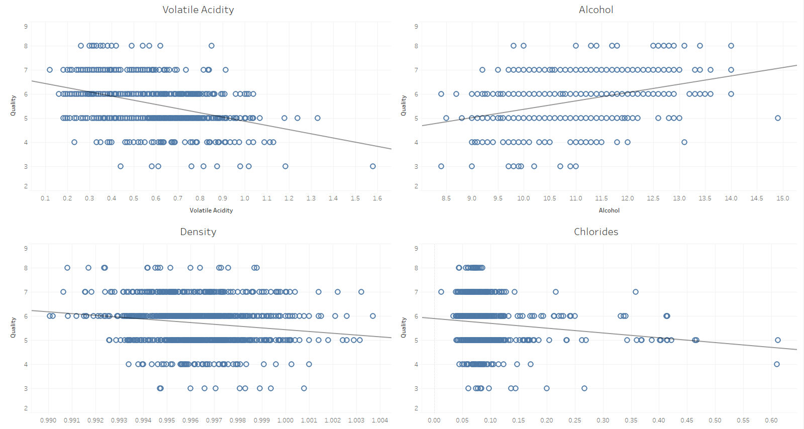
RED Wine Trends

Slide 8
White Wine Model
 | Precision | Recall | f1-score | Support
Average | 0.84 | 0.89 | 0.86 | 917
Bad | 0.38 | 0.15 | 0.21 | 41
Good | 0.61 | 0.54 | 0.58 | 267
Accuracy |  |  | 0.79 | 1225
Macro Avg | 0.61 | 0.53 | 0.55 | 1225
Weighted Avg | 0.77 | 0.79 | 0.78 | 1225

Slide 9
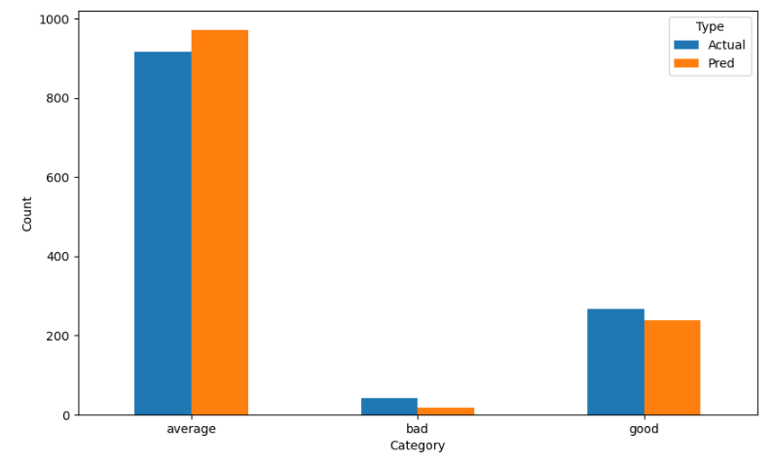
White Wine Model

Slide 10
Red Wine Model
 | Precision | Recall | f1-score | Support
Average | 0.89 | 0.93 | 0.91 | 336
Bad | 0.25 | 0.06 | 0.10 | 17
Good | 0.51 | 0.49 | 0.50 | 47
Accuracy |  |  | 0.84 | 400
Macro Avg | 0.55 | 0.49 | 0.50 | 400
Weighted Avg | 0.82 | 0.84 | 0.83 | 400

Slide 11
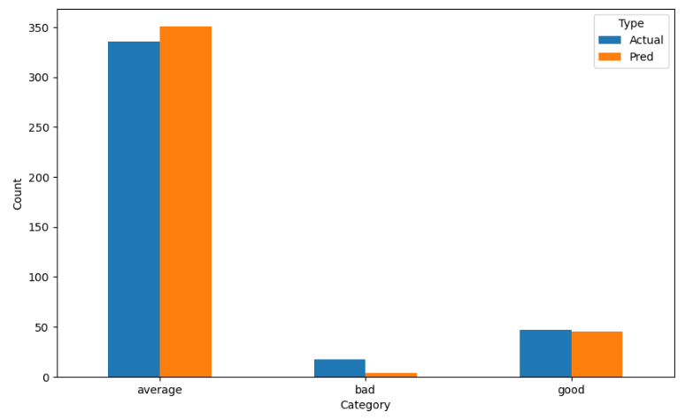
Red Wine Model

Slide 12
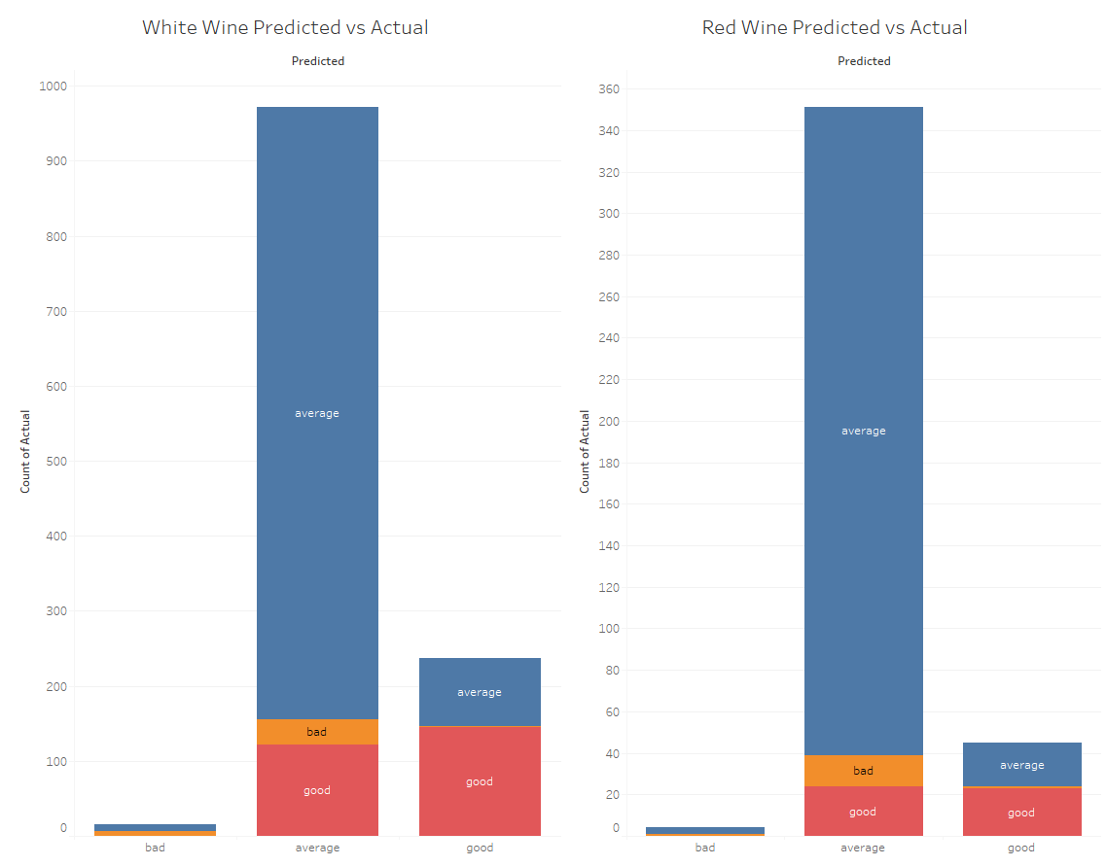
Predicted vs Actual

Slide 13
Conclusions
Both data models exceeded the goal of 75% accuracy
Red wine 84%, White wine 79%
The models were very good at predicting “Average” ratings
Not as efficient with “Good” and “Bad” ratings
Limitations:
No data on grape types
Low number of “Good” and “Bad” ratings
Unsure if all input variables are relevant
Interested to test feature selection methods to lower the complexity of the model

Slide 14
Citations
P. Cortez, A. Cerdeira, F. Almeida, T. Matos and J. Reis. Modeling wine preferences by data mining from physicochemical properties. In Decision Support Systems, Elsevier, 47(4):547-553. ISSN: 0167-9236.
Red Wine Quality, https://www.kaggle.com/datasets/uciml/red-wine-quality-cortez-et-al-2009
Beginner’s Guide To Vinho Verde Wine, https://winefolly.com/deep-dive/vinho-verde-the-perfect-poolside-wine-from-portugal/
GitHub: https://github.com/dsyrjanen/wine-reviews

